Slide 1
NLP

Slide 2
Introduction to NLP
Combinatory Categorial Grammar (CCG)

Slide 3
Combinatory Categorial Grammar (CCG)
Complex types
E.g., X/Y and X\Y
These take an argument of type Y and return an object of type X.
X/Y – means that Y should appear on the right
X\Y – means that Y should appear on the left
Notes:
PROVENANCE

Slide 4
Structure of CCG
Categories
Combinatory rules
Lexicon

Slide 5
CCG Rules
Function composition
X/Y Y/Z -> X/Z
X\Y Z\X -> Z\Y
X/Y Y\Z -> X\Z
X/Y Z\X -> Z/Y
Type raising
X -> Y/(Y\X)
X -> Y\(Y/X)
Coordination

Slide 6
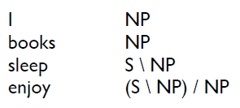
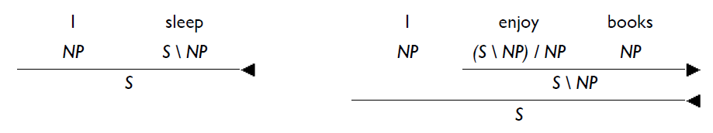
Example
Example from Jonathan Kummerfeld, Aleka Blackwell, and Patrick Littell
Notes:
PROVENANCE

Slide 7
Expressive power
CCGs can generate the language a^{n}b^{n}c^{n}d^{n}, n>0
Interesting examples:
I like New York
I like and hate New York
I like and would rather be in New York
I gave a book to Chen and a laptop to Jorge
I want Chen to stay and Jorge to leave
I like and Chen hates, New York
Where are the verb phrases?
Notes:
PROVENANCE

Slide 8
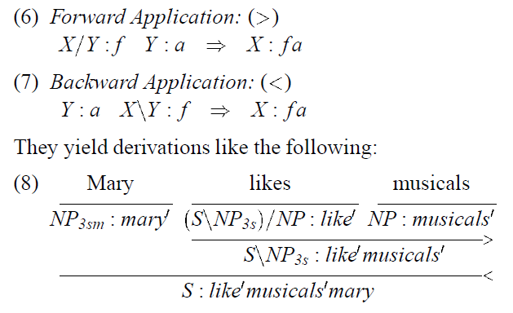
Examples from Steedman 1996

Slide 9
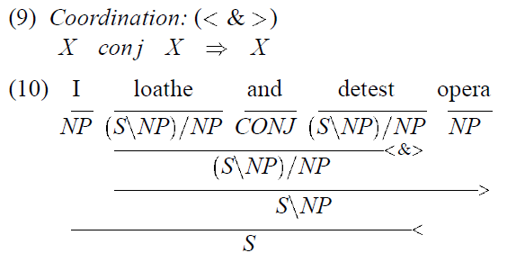

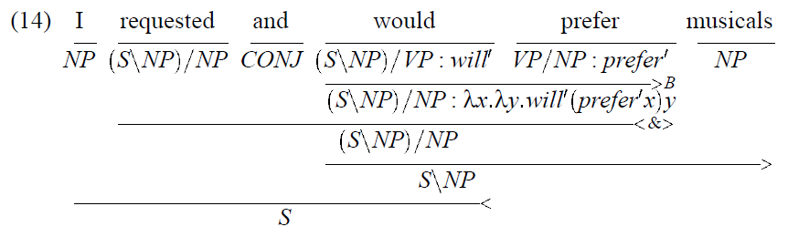
Examples from Steedman 1996

Slide 10
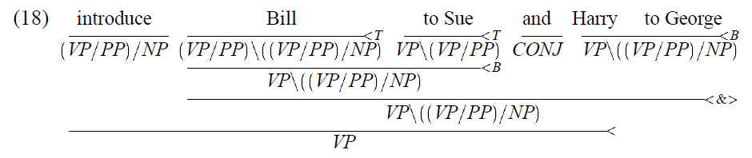
Examples from Steedman 1996

Slide 11
CCG in NLTK
from nltk.ccg import chart, lexicon
lex = lexicon.parseLexicon('''
:- S, NP, N, VP
Det :: NP/N
Pro :: NP
Modal :: S\\NP/VP
TV :: VP/NP
DTV :: TV/NP
the => Det
that => Det
that => NP
I => Pro
you => Pro
we => Pro
chef => N
cake => N
children => N
dough => N
will => Modal
should => Modal
might => Modal
must => Modal
and => var\\.,var/.,var
to => VP[to]/VP
without => (VP\\VP)/VP[ing]
be => TV
cook => TV
eat => TV
cooking => VP[ing]/NP
give => DTV
is => (S\\NP)/NP
prefer => (S\\NP)/NP
which => (N\\N)/(S/NP)
persuade => (VP/VP[to])/NP
''')
http://www.nltk.org/howto/ccg.html

Slide 12
CCG in NLTK
parser = chart.CCGChartParser(lex, chart.DefaultRuleSet)
for parse in parser.parse("you prefer that cake".split()):
chart.printCCGDerivation(parse)
break
you prefer that cake
NP ((S\NP)/NP) (NP/N) N
-----
NP
-------------
((S\NP)/NP)
--------
(NP/N)
------
N
-------------->
NP
--------------------------->
(S\NP)
--------------------------------<
S
http://www.nltk.org/howto/ccg.html

Slide 13
for parse in parser.parse("that is the cake which you prefer".split()):
chart.printCCGDerivation(parse)
break
that is the cake which you prefer
NP ((S\NP)/NP) (NP/N) N ((N\N)/(S/NP)) NP ((S\NP)/NP)
------
NP
-------------
((S\NP)/NP)
--------
(NP/N)
------
N
----------------
((N\N)/(S/NP))
-----
NP
----->T
(S/(S\NP))
-------------
((S\NP)/NP)
------------------>B
(S/NP)
---------------------------------->
(N\N)
----------------------------------------<
N
------------------------------------------------>
NP
------------------------------------------------------------->
(S\NP)
-------------------------------------------------------------------<
S
http://www.nltk.org/howto/ccg.html

Slide 14
CCG
NACLO problem from 2014
Authors: Jonathan Kummerfeld, Aleka Blackwell, and Patrick Littell
http://www.nacloweb.org/resources/problems/2014/N2014-O.pdf
http://www.nacloweb.org/resources/problems/2014/N2014-OS.pdf
http://www.nacloweb.org/resources/problems/2014/N2014-P.pdf
http://www.nacloweb.org/resources/problems/2014/N2014-PS.pdf

Slide 15
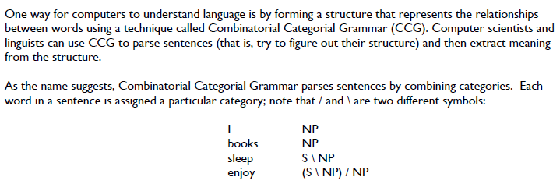
CCG problem in NACLO

Slide 16
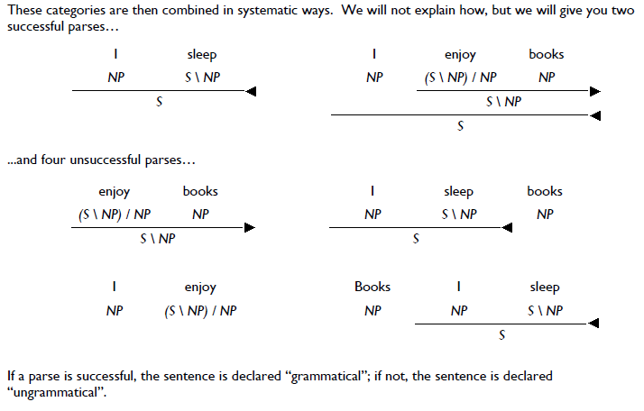
CCG

Slide 17
CCG

Slide 18
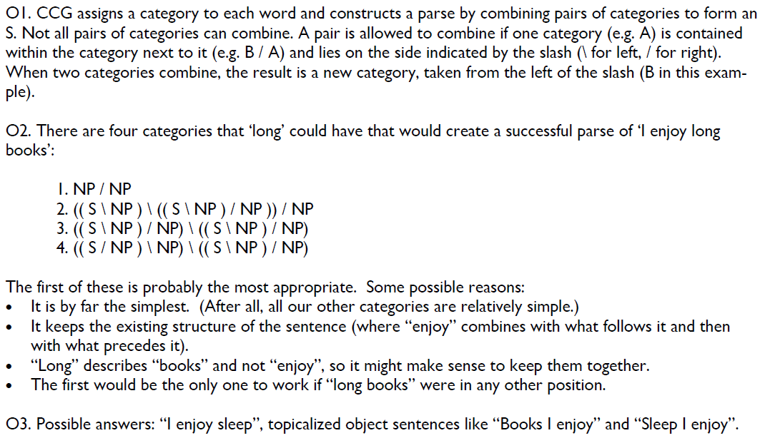
Answer

Slide 19
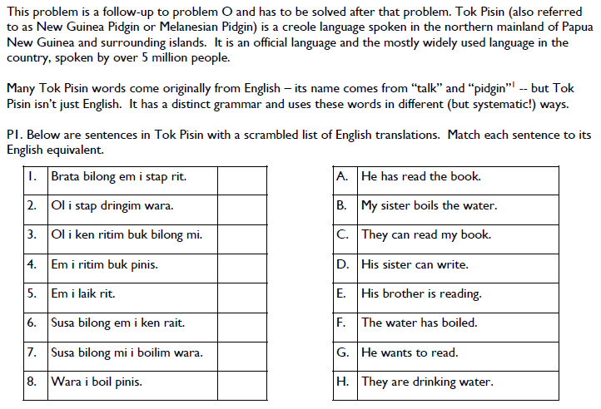
CCG

Slide 20
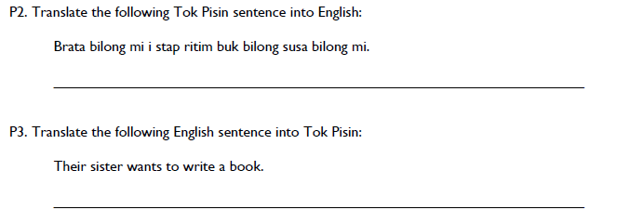
CCG

Slide 21
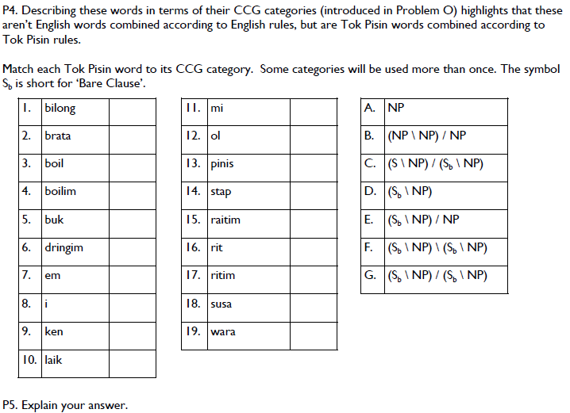
CCG

Slide 22
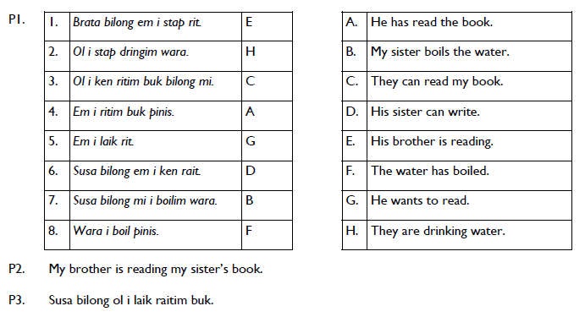
CCG

Slide 23
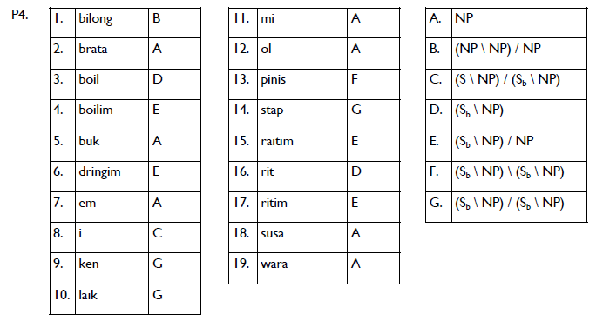
CCG

Slide 24
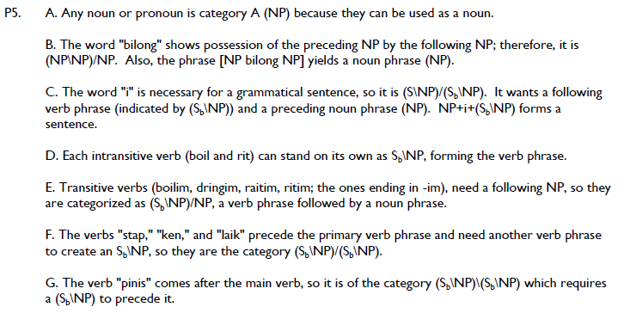
CCG

Slide 25
CCG Parsing
CKY works fine
http://openccg.sourceforge.net/

Slide 26
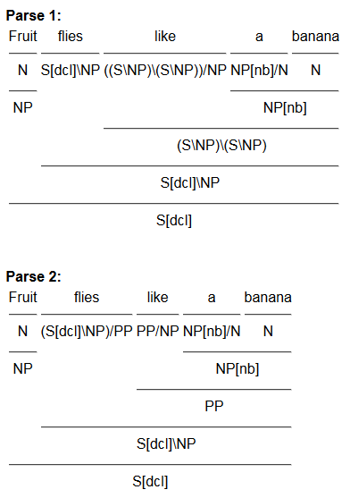
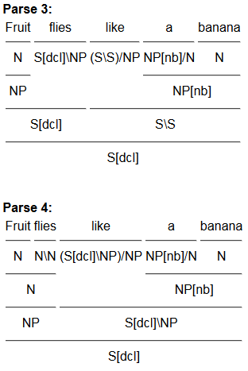
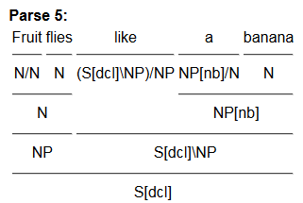
http://4.easy-ccg.appspot.com/do_parse?sentence=Fruit+flies+like+a+banana&nbest=5

Slide 27
Exercise
How do you represent the following categories in CCG
Nouns
Adjectives
Articles
Prepositions
Transitive verbs
Intransitive verbs

Slide 28
Exercise
How do you represent the following categories in CCG
Nouns N
Adjectives N/N
Articles NP/N
Prepositions (NP\NP)/NP
Transitive verbs (S\NP)/NP
Intransitive verbs

Slide 29
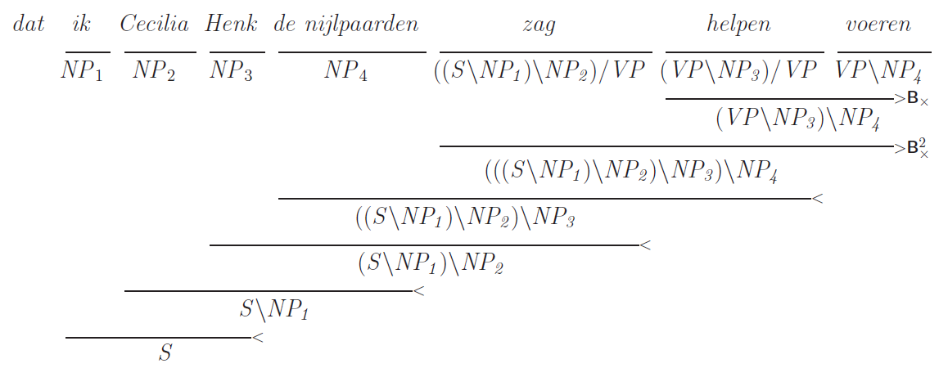
CCG for Dutch Cross-Serial Dependencies
… because I₁ Cecilia₂ Henk₃ the hippopotamuses₄ saw₁ help₂ feed_{3,4}.
[Example from Stephen Clark]

Slide 30
Notes
CCG is mildly context-sensitive
It can handle some phenomena that are not CFG
But it can be parsed efficiently
CCG rules are monotonic
Movement is not allowed
Complexity
O(n³) – with restricted type raising
Unbounded – with unrestricted type raising
CCG gets closer to semantics and lambda calculus

Slide 31
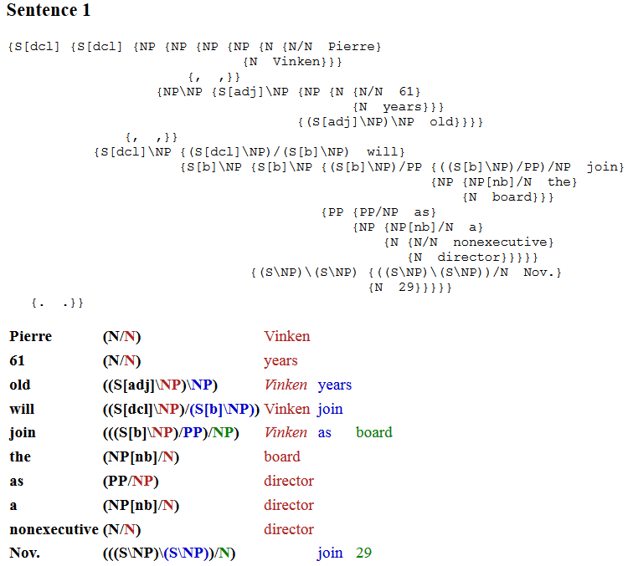
CCGBank
Hockenmaier and Steedman (2005)

Slide 32
NLP

